Slide 1
Building Numbers Different Ways

Slide 2
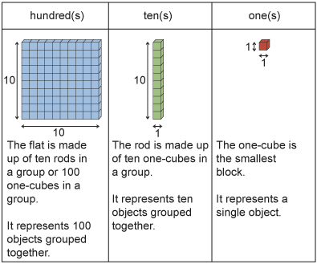
Let’s Review….

Slide 3
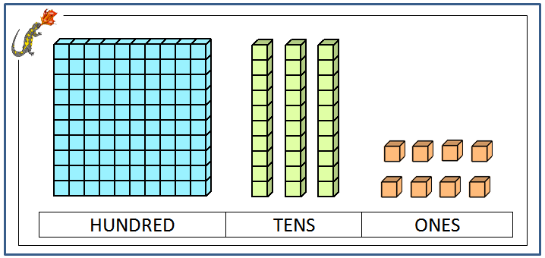
Let’s Review…
What is the value of these blocks?

Slide 4
What is another way I could show 138?
Move this!
Any others?

Slide 5
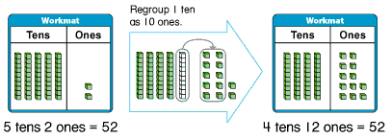
Can you think of another way to make 52?

Slide 6
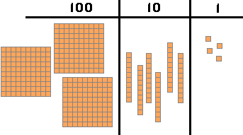
Value?
How else can you build
it?

Slide 7
Let’s try a few more…
537

Slide 8
Let’s try a few more…
653

Slide 9
Let’s try a few more…
236

Slide 10
Let’s try a few more…
236

