Slide 1
CMS Area Day 1
Objective: I can measure the area of irregular shapes using square units.

Slide 2
EOG Prep

Slide 3
Area
We already worked with perimeter, and importance of figuring out the perimeter of a shape… for instance, to keep crazy third graders on the playground, we may need to build a fence around the playground. We would need to know the length around the playground to buy enough fencing.
Sometimes it is important to know how much space we have inside a 2D shape. Why might that be important?
We call the space inside of a 2D shape the area. We can measure area by covering the shape with squares and counting how many squares it took to cover the shape. When we use squares to measure area, we call them square units.

Slide 4
Finding Area using Square Units
Drag Square
Units to measure
the shape.
What is the area
of this shape?

Slide 5
Independent
Each table will get 10 shapes (A-J).
As a group, estimate and list the order the shapes from smallest to largest on your recording sheet.
Each students needs to measure each shape using square unit tiles (if there aren’t enough tiles, take turns measuring the shapes.
Record the area of each shape on your sheet.
Reorder and list the shapes from smallest to largest on your recording sheet.

Slide 6
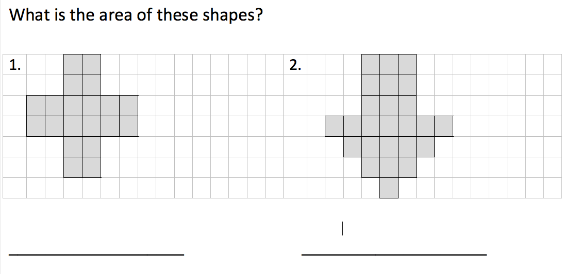
Exit Ticket

